Slide 1
World War I

Slide 2
How it all began…
After the Congress of Vienna in 1815, Europe experienced almost a century of fairly peaceful existence.
During this time nationalism, imperialism, and militarism influenced the growth of the European nations.
Alliances were formed between Germany and Austria-Hungary; Russia and France; and loosely between Great Britain and France.

Slide 3
Increasing tensions…
Germany had gained Alsace-Lorraine, French want it back
Pan-Slavism – belief that all Slavs share a common nationality; sponsored by Russia
  Makes Austria-Hungary and Ottoman Turkey nervous
1912 – some Balkan states attack Turkey, tensions are high
  Balkans considered the “powder keg of Europe”

Slide 4
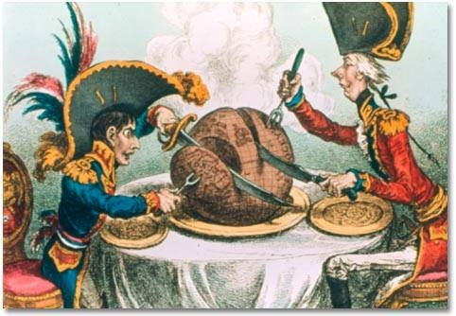
Imperialism

Slide 5
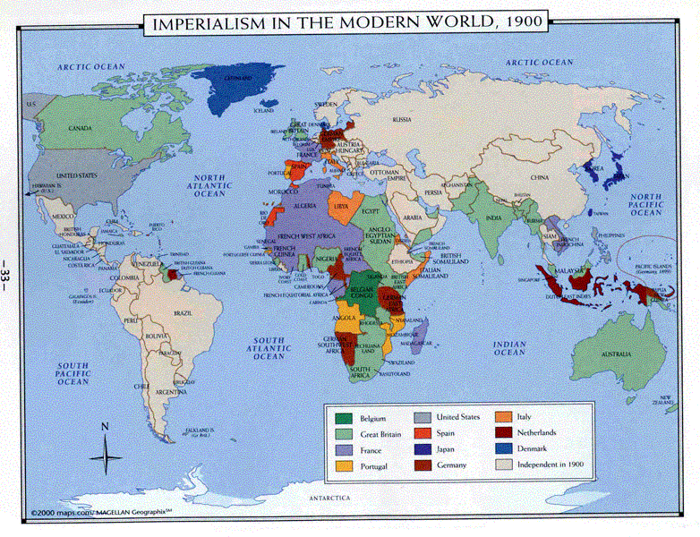

Slide 6
Militarism
Social Darwinism and “survival of the fittest”
Expansion of armies and navies

Slide 7
Planning Ahead
1882 – Triple Alliance forms between Germany, Italy and Austria-Hungary
1894 – France and Russia form alliance
1904 – France and Britain sign an entente
  Similar Britain and Russia agreement
Germany and Ottomans = treaty
Britain close w/ Japan

Slide 8
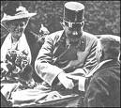
June 28, 1914
Archduke Francis Ferdinand of Austria-Hungary is assassinated by Serbian nationalist Gavrilo Princip in Sarajevo, Bosnia.
With Germany’s support, Austria-Hungary made specific demands on Serbia.
Serbia sought Russia’s protection and refused to meet Austria’s demands.
July 28, 1914 Austria-Hungary declares war on Serbia

Slide 9
All in it Together
July 29, Russia begins mobilization
Germany declares war on Russia after the Russians refuse to stop mobilizing.
Germany and Austria-Hungary v. Russia, France, and Serbia
Schlieffen Plan – German plan to sweep through Belgium and France quickly before Russia could mobilize so that the German forces could focus on Russia after taking over the Western front.
Britain joins the war once Germany invades Belgium and the British feel the Germans are too close for comfort (Join Aug 4)
By the end of 1914 Ottoman Empire (Turkey) enters the war on the side of the Central Powers; Italy and Romania join in 1915 on the Entente side; Bulgaria 1915 for the CP;

Slide 10
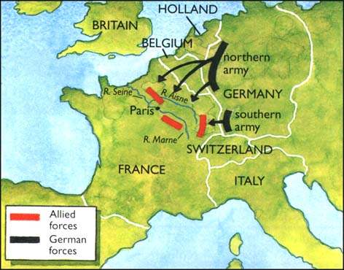
Schlieffen Plan

Slide 11
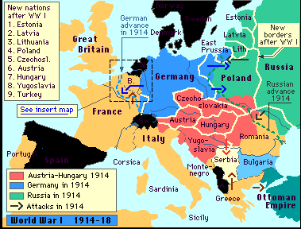

Slide 12
Central Powers v. Allies
Central Powers (Triple Alliance)
  Germany, Austria-Hungary, and later the Ottoman Empire and Bulgaria
Allies (Triple Entente)
  Russia, France, and Britain (later Japan, Italy, Romania, and US)

Slide 13
Modern Warfare
Machine guns (450 rounds per minute)
Rapid fire artillery
Poison gases
Hand grenades
Mortar
Results?
  Modern Warfare results in expansive casualty and death tolls.

Slide 14
The Western Front
First Battle of Marne, 1914
  And the trenches begin…
The Battle of Verdun, 1916
  A ten month ordeal between the French and German armies
    February – December (the longest battle of WW I)
  Estimated 540,000 French and 430,000 German casualties
  One of the most brutal and intense battles of WWI
  “battlefield with the highest density of dead per square yard”

Slide 15
War of Attrition
Survival of the fittest, best supplied, most populous
  French Commander in Chief – Joffre
  “battle of attrition, the aim being to drain the German forces of reserves, although territorial gain was a secondary aim” http://www.firstworldwar.com/battles/somme.htm
First war the generals are not on the front lines with their men

Slide 16
The Western Front
Battle of Somme, 1916
  “58,000 British troops (one third of them killed) on the first day of the battle, 1 July 1916, which to this day remains a one-day record”
  Lasted from July-November
  “Since the 1st July, the British has suffered 420,000 casualties. The French lost nearly 200,000 and it is estimated that German casualties were in the region of 500,000. Allied forces gained some land but it reached only 12km at its deepest points”

Slide 17
The Eastern Front
Battle of Tannenburg, August 1914
  First face off between Germany and Russia
  Disastrous casualties for the Russians
  Russian General Samsonov commits suicide after they lose
  Only 10,000 of the 150,000 Russians managed to escape; 92,000 were prisoners
    The loss was kept secret from the British public

Slide 18
US neutrality
Wilson calls for neutrality in both thought and deed.
Both sides in Europe are trying to win over the United States
US has close cultural, linguistic, and economic ties to Britain
  Britain uses propaganda to its fullest to denounce the “evil” Germans
Germany and Austria-Hungary had at least one foreign-born parent with blood ties to CP numbered about 11 million in 1914.
  Germany and AH hoping for sympathies from German-Americans in the US.

Slide 19
Economics
US still maintained trade with Britain and France.
The CP protested, but the US was not violating the international neutrality laws.
Germany was free to trade with the US but had difficulty because of geography (and Britain’s naval blockade across the North Sea)
Britain began forcing American vessels into British ports, which fully terminated US-German trade
Germany announced submarine war around the British Isles

Slide 20
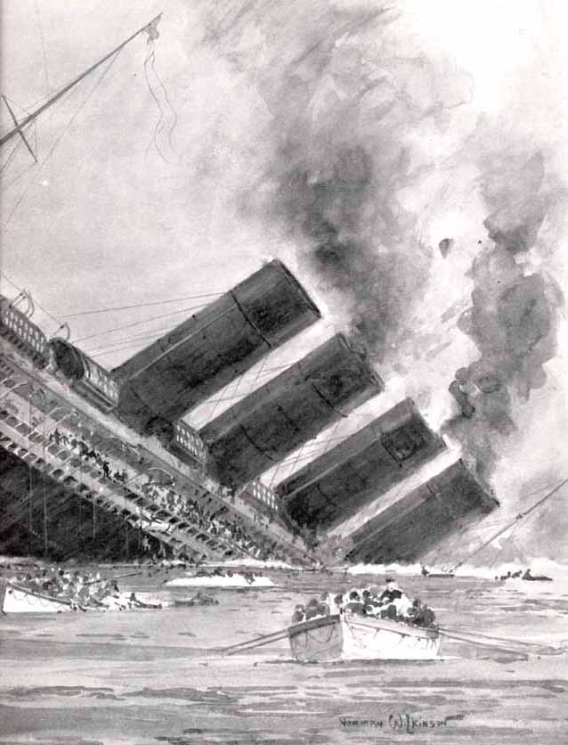
Submarine Warfare
In the first few months of 1915, German U-boats sank about 90 ships in the war zone.
Lusitania, British passenger line was sunk May 7, 1915. 1,198 lives lost including 128 Americans.
Submarine aggression continues, US demands Germany cease
After several more ships are sunk by German U-boats, the Germans finally agree to not sink ships without warning.

Slide 21
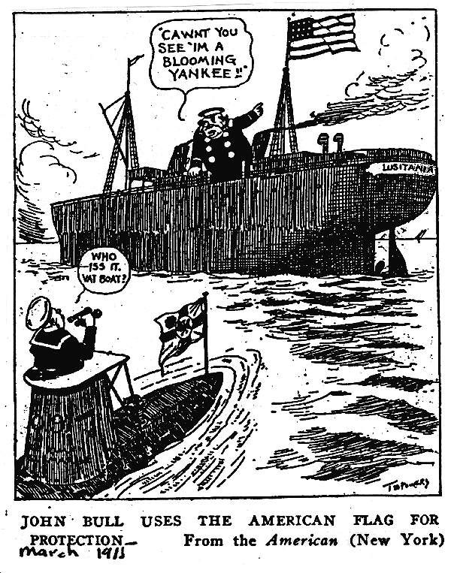

Slide 22
War Preparedness in the United States
While Wilson was reluctant to enter the war, he did begin war preparations
Authorized bankers to make huge loans to the Allies.

Slide 23
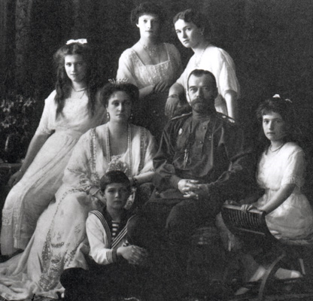
Russia and the Romanovs
Czar Nicholas II
Russian public extremely upset about WW I
  Casualties are extraordinarily high
People are restless, want reform, social conditions are very poor

Slide 24
Entering in…
Zimmerman Note – January 1917
  (intercepted by British; dispatched by Arthur Zimmerman (For. Sec. of Germany)
German U-boats sink the US ships City of Memphis and Vigilancia
Resumption of Unrestricted Submarine Warfare
On March 20, 1917 Wilson’s Cabinet unanimously voted for war.
On April 2 Wilson appealed to Congress, claiming “the world must be made safe for democracy”
April 6, 1917 Woodrow Wilson and the United States entered the war.

Slide 25
Russia turns Red
Lenin pulls out of WWI with the Treaty of Brest-Litovsk, March 3, 1918.
Germany wins a great deal of Russian land
Russia’s truce allows Germany to focus on the Western front.

Slide 26
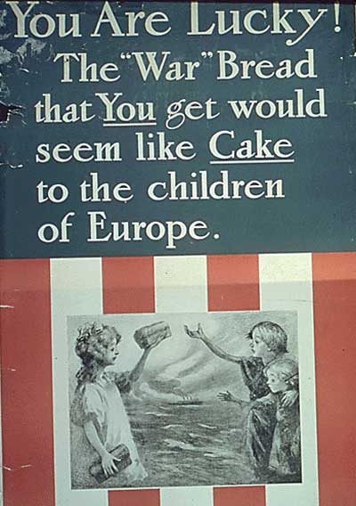

Slide 27
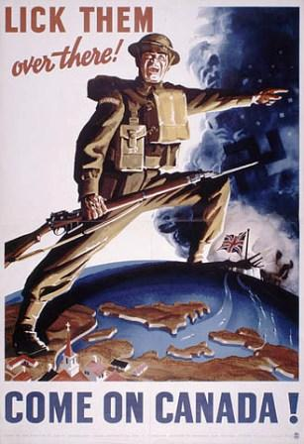

Slide 28
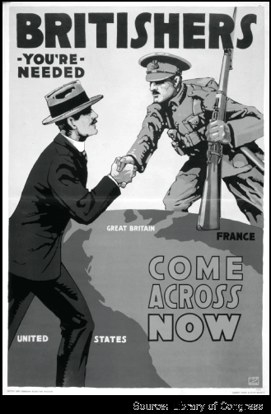

Slide 29
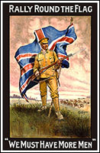

Slide 30
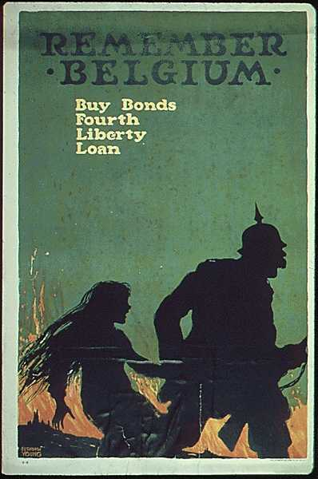

Slide 31
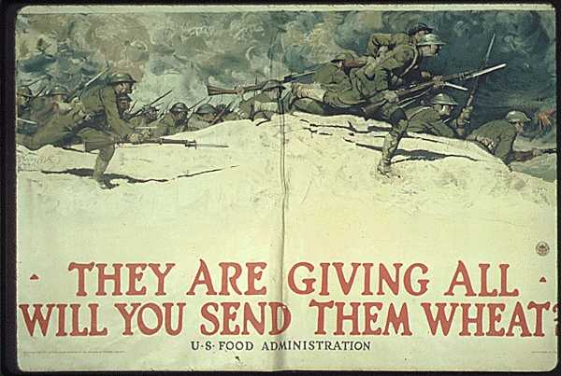

Slide 32
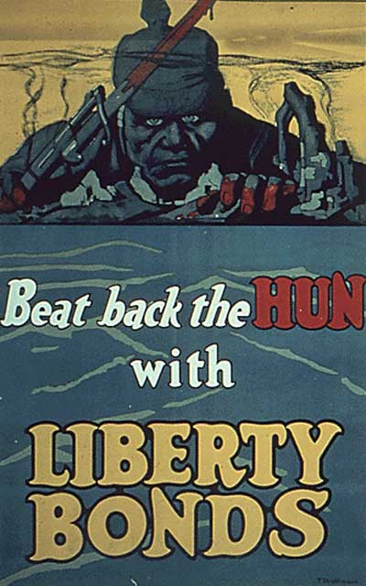

Slide 33
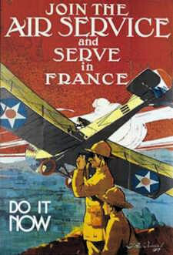

Slide 34
Germany nears Paris
Break through British lines and advance deep into enemy territory.
Between March and May they advance within 50 miles of Paris.
US General Pershing stop the advance at the B of Chateau-Thierry

Slide 35
New Weapons
The Tank – could cross trenches and barb wire with ease
Planes – dogfights, The Red Baron – Manfred von Richthofen, “aces”
German Zeppelins and bombers launched 100+ raids on London, killing 1,500 civilians
Bombing raids began

Slide 36
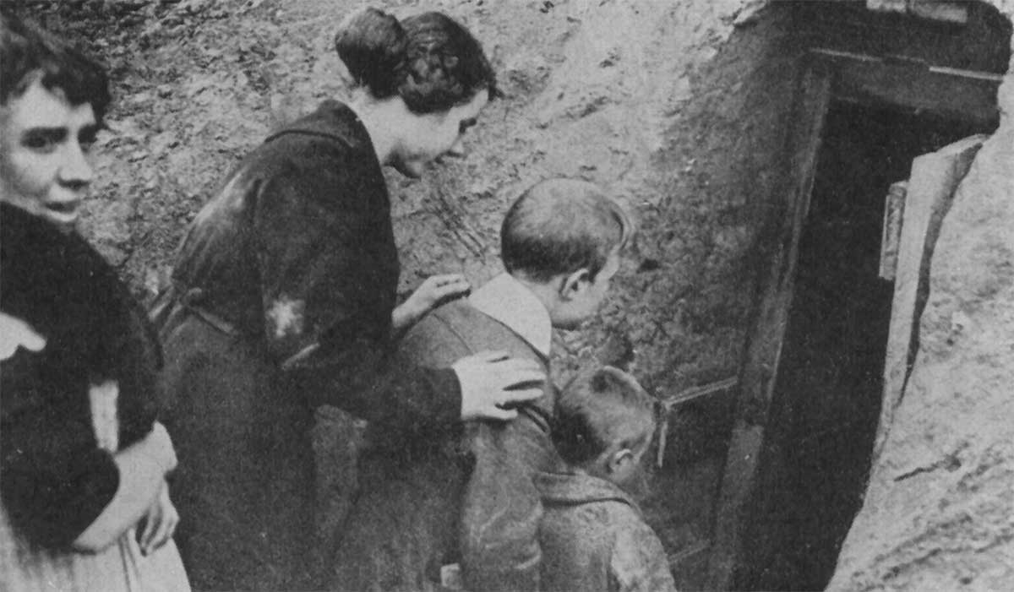
Londoners seeking protection

Slide 37
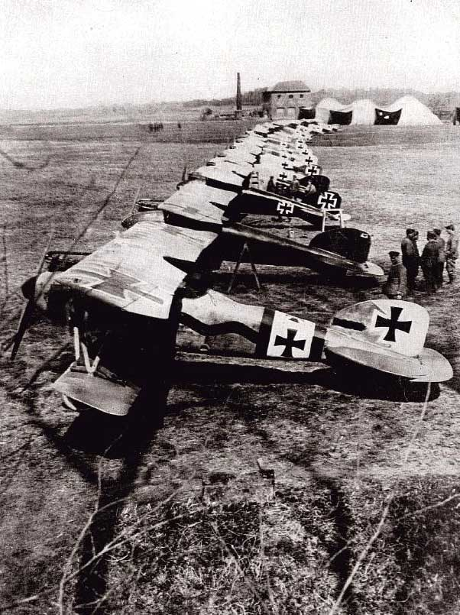
German squadron of planes

Slide 38
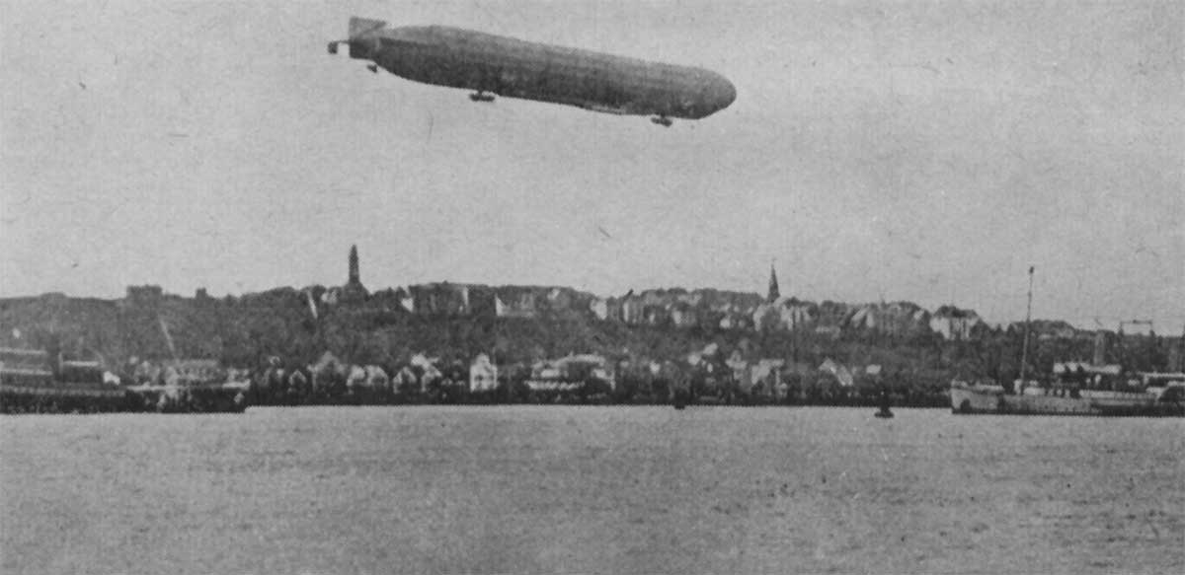
German Zeppelin

Slide 39
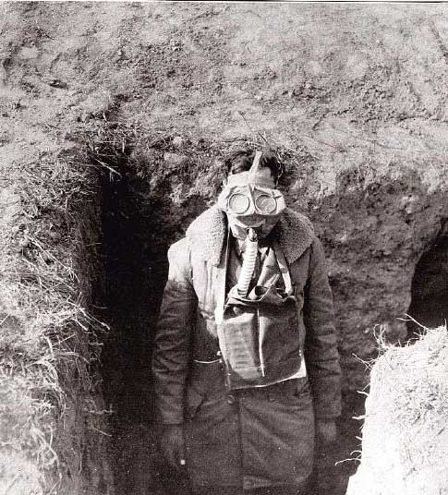
American soldier with gas mask

Slide 40
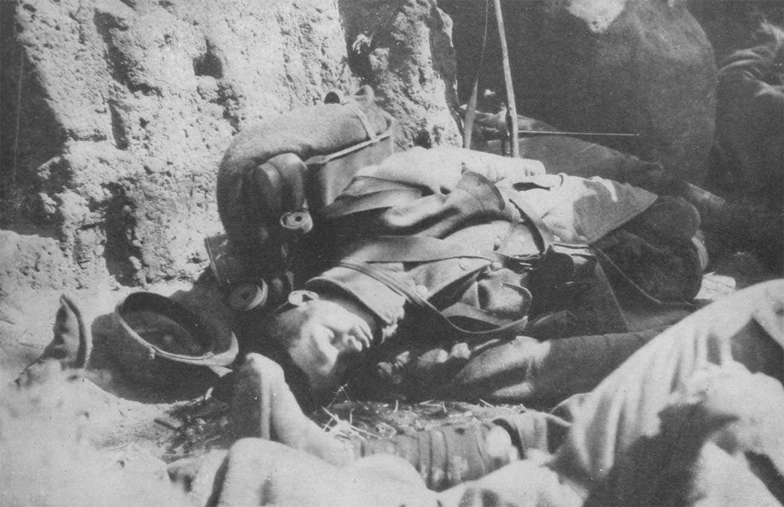
Effects of poison gas

Slide 41
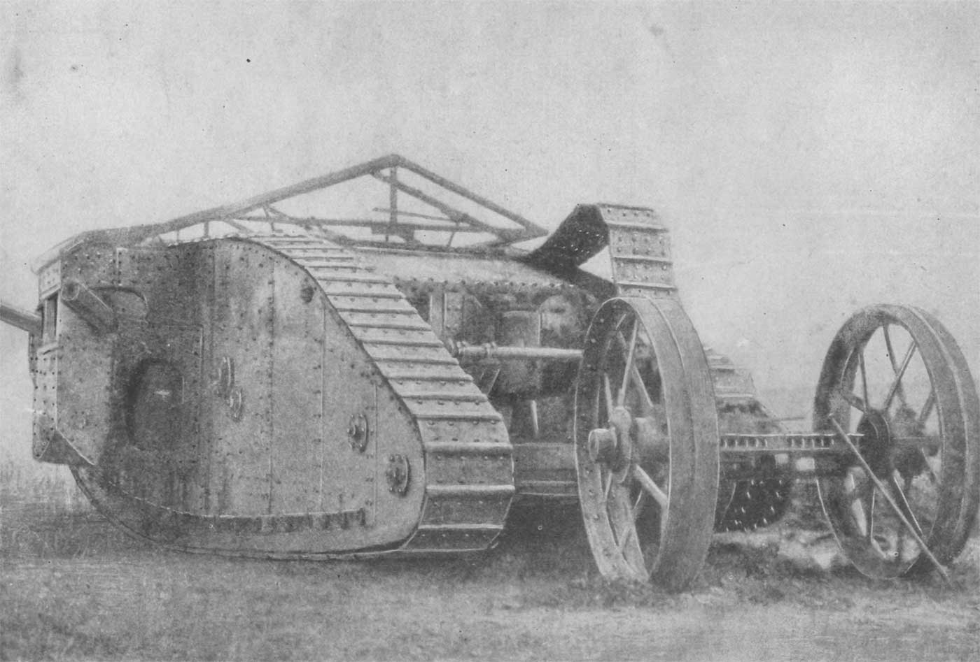
British tank

Slide 42
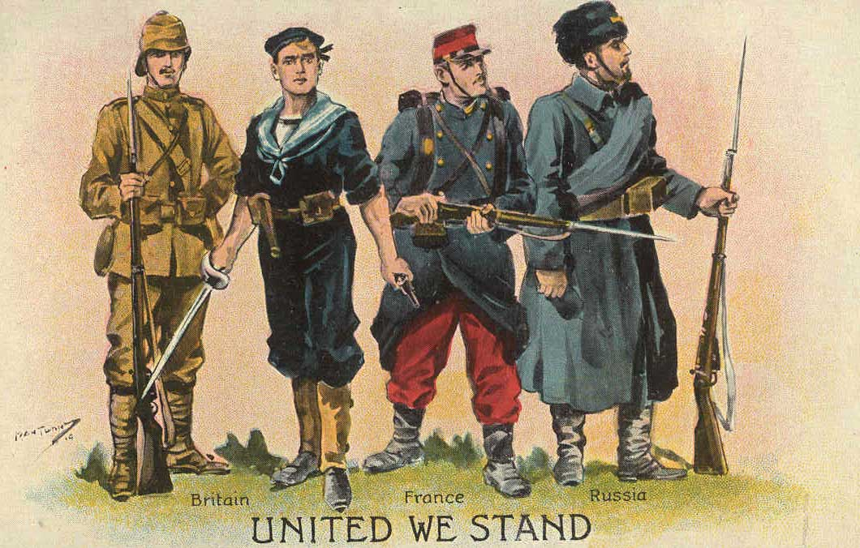
British postcard

Slide 43
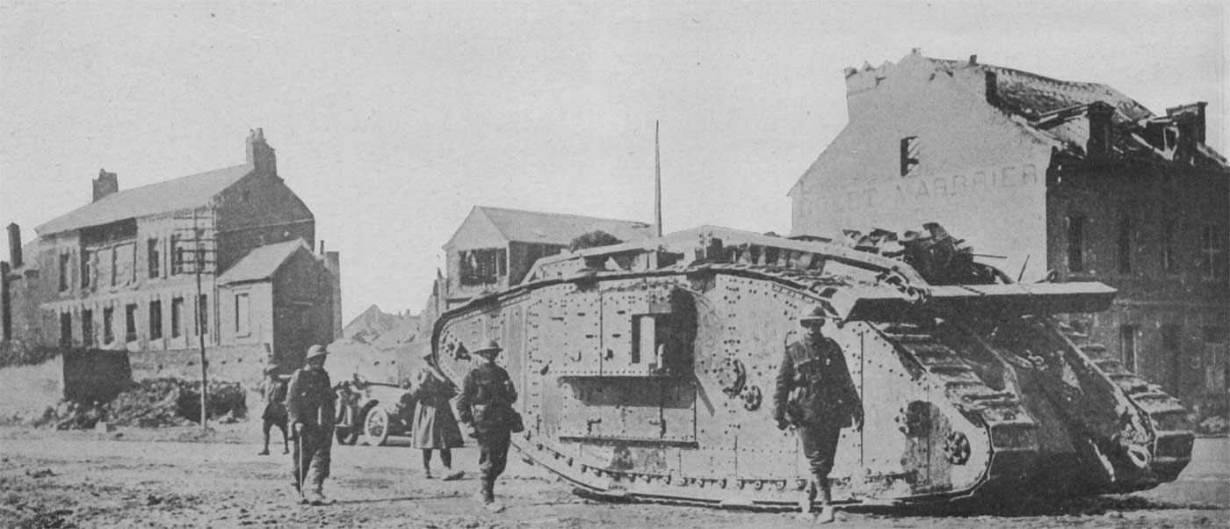
British tank

Slide 44
Armistice
On the eleventh hour of the eleventh day of the eleventh month of 1918, an armistice was signed to end the first world war.

Slide 45

Paris Peace Conference
David Lloyd George
  Great Britain
Georges Clemenceau
  France
Vittorio Orlando
  Italy
Woodrow Wilson

Slide 46
Treaty of Versailles
Germany – loses Alsace-Lorraine to France, land to Belgium, Saar Land to France, N. Schleswig to Denmark, Danzig named an international city, Polish corridor to Poland, and loses all colonies
Poland – receives Silesia and is recognized as a country again
Anschluss is forbidden
Armament Provisions
  German navy and airforce is eliminated
  Limited to an army of 100,000 men
    Allowed to keep an army in case of a communist uprising in Europe
Rhineland – Permanently demilitarized
Article 231 – Guilt Clause
League of Nations established
Article 232 – Restitutions – Billed for $33 Billion

Slide 47
Allies do not weaken Germany well – they humiliate them, but do not keep them from coming back
It’s a bad treaty, but probably the best of its time

Slide 48
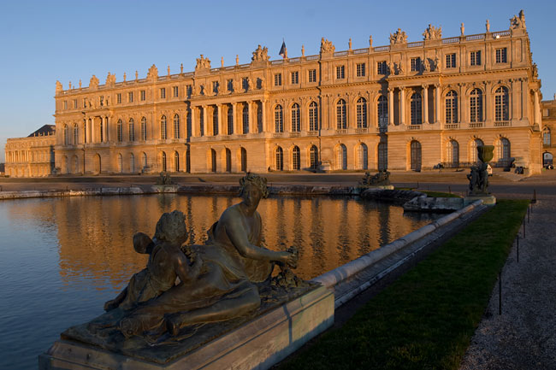
Treaty of Versailles
Signed June 28, 1919 after much debate and hesitancy from Germany.

Slide 49
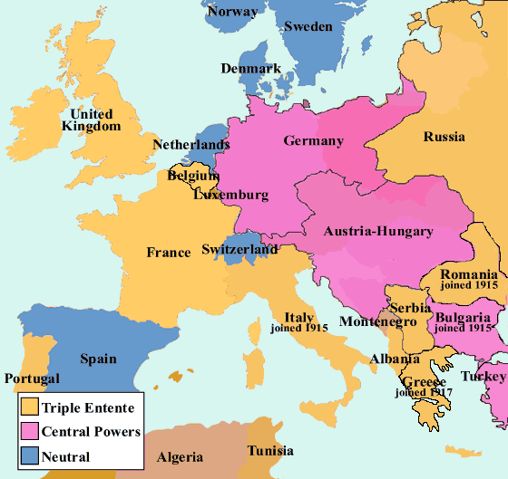
Europe 1914

Slide 50
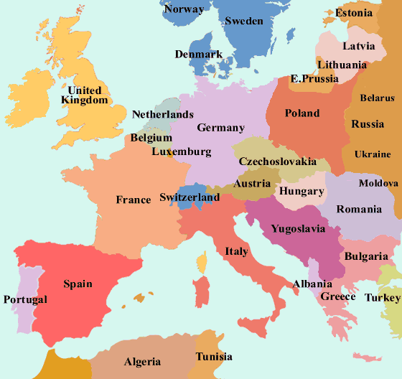
Europe 1919

Slide 51
Costs of War
Pandemic - 1918
  La grippe
  50 to 100 million died worldwide
Financial Burdens
Casualties
  8 million soldiers; 6 million civilians
  Almost every family in Europe had a brother, son, or husband killed or seriously wounded
  France lost 20% of its male pop. b/n the ages of 20-44; Germany lost 15%
Pyrrhic Victory?
Dissolutionment and the Lost Generation

Slide 52
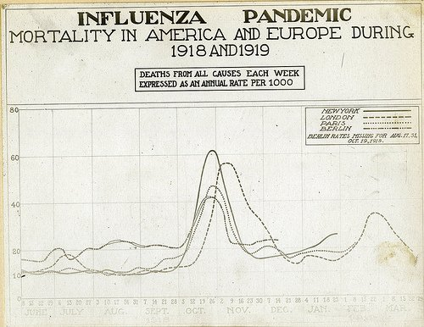

Slide 53
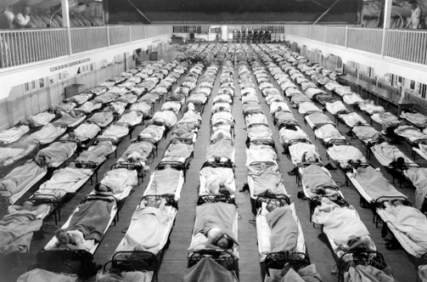

Slide 54
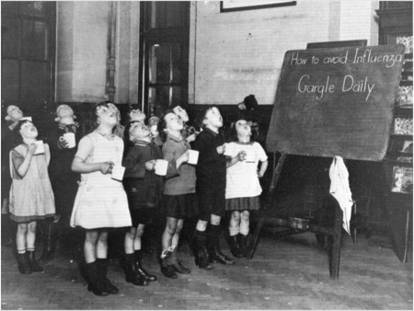

Slide 55
I had a little bird,
  Its name was Enza.
  I opened the window,
  And in-flu-enza.

Slide 56
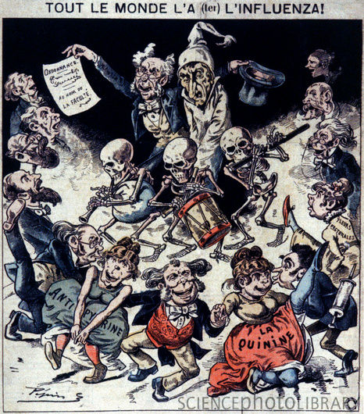
Notes:
H1N1 1918 flu pandemic. Historical caricature of the 1918 influenza pandemic. Also called the Spanish flu, this pandemic killed between 50 and 100 million people worldwide between 1918 and 1920. Skeletons are playing musical instruments while a doctor standing next to a patient displays a public quarantine notice signed "in the name of the Faculty". Cities that put quarantines in place had lower death rates than those that didn't. Across bottom, three drug measures are named: antipyrine (a drug used to treat influenza and fevers since 1884), quinine (used as an antiseptic gargle with little success), and fleurs pectorales (a traditional herbal remedy). This French artwork dates from the early 20th century.
http://www.sciencephoto.com/media/300588/enlarge

Slide 57
